Slide 1


ConnectLink Network Infrastructure
Implementation
NAME - PRANIDHI PEIRIS
STUDENT ID - 1853364

Slide 2


Project Scope & Objectives
Company: ConnectLink (3-floor office building)
SCOPE
Wires and wireless access on all the floors
VLANs for each department
Centralized routing and DHCP
Remote access setup (SSH & Port Security)
OBJECTIVES
Full inter-department communication
Future-ready, modular infrastructure
Build a scalable, secure, and efficient network

Slide 3

NETWORK DESIGN
WALKTHROUGH

Slide 4
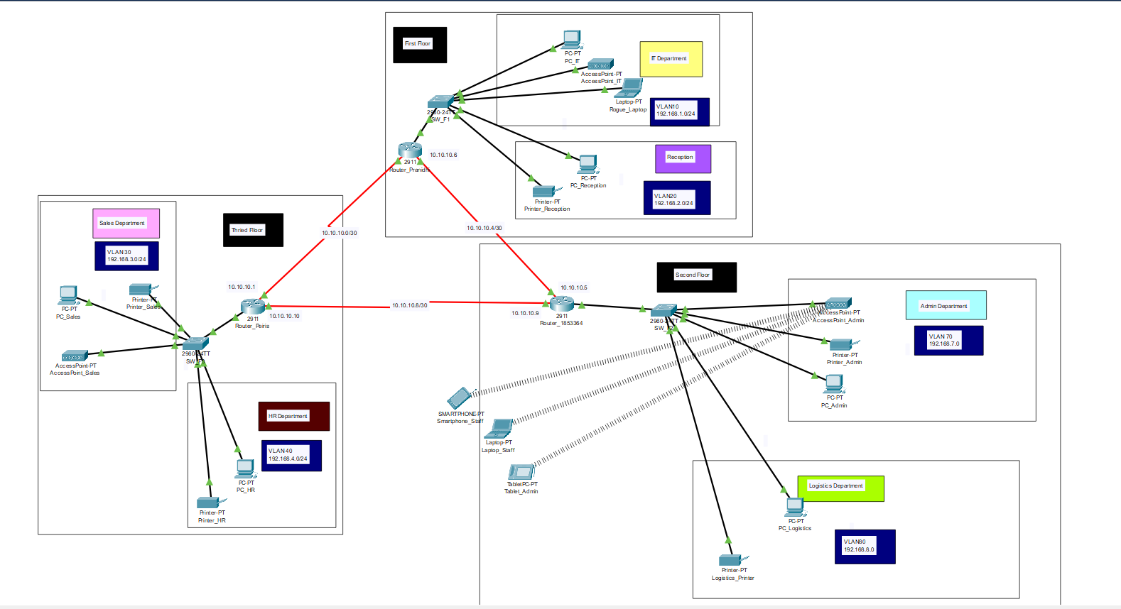
NETWORK DESIGN

Slide 5
KEY FUNCTIONALITIES
DEMONSTRATION
DHCP on Routers
Inter-VLAN Routing
SSH Configuration
Auto-assign IPs based on VLAN.
Enabled via Router-on-a-Stick
OSPF
Secure remote access to routers
Port Security
Rogue Laptop Setup
FULLY COMMUNICATION TESTING
Sticky MAC on Fa0/5
Violation mode: Shutdown
Connected to Fa0/5 for testing SSH
.
Ping across VLANs
Wireless devices connectivity

Slide 6
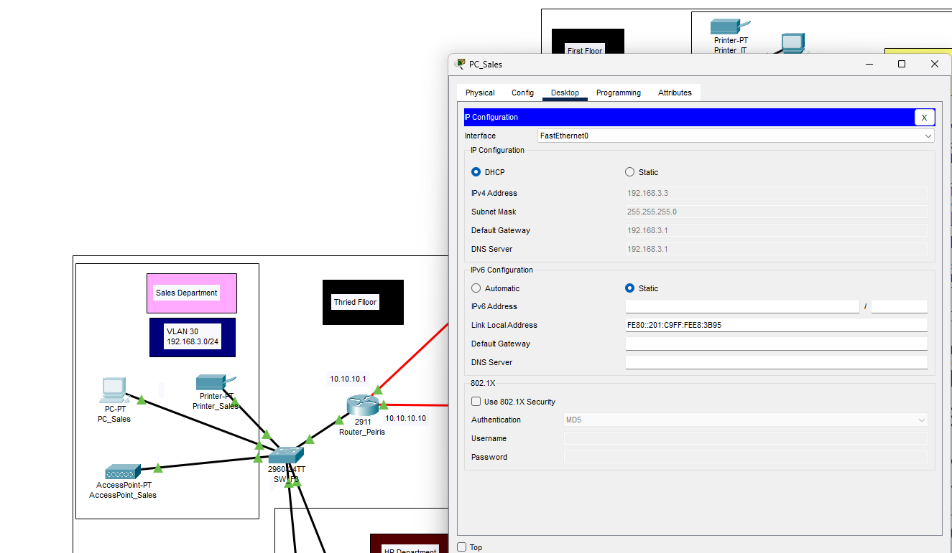
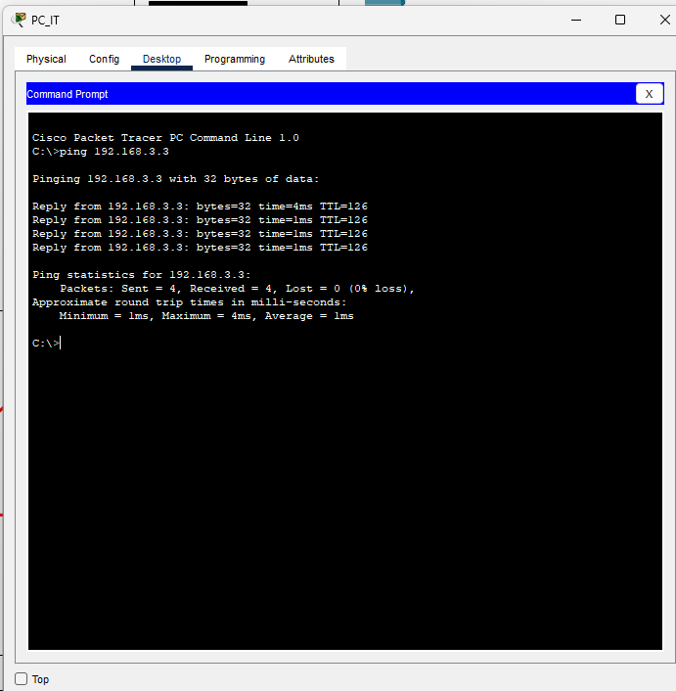
DHCP Configuration
Inter-VLAN Routing

Slide 7
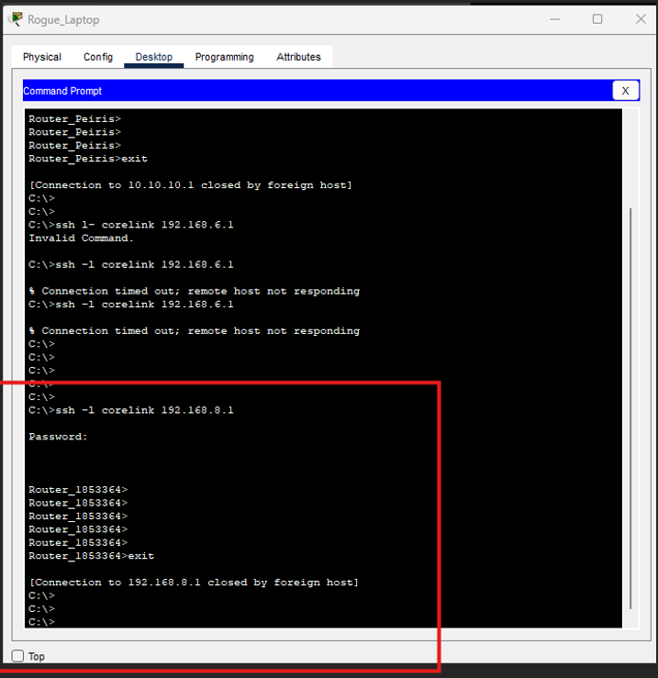
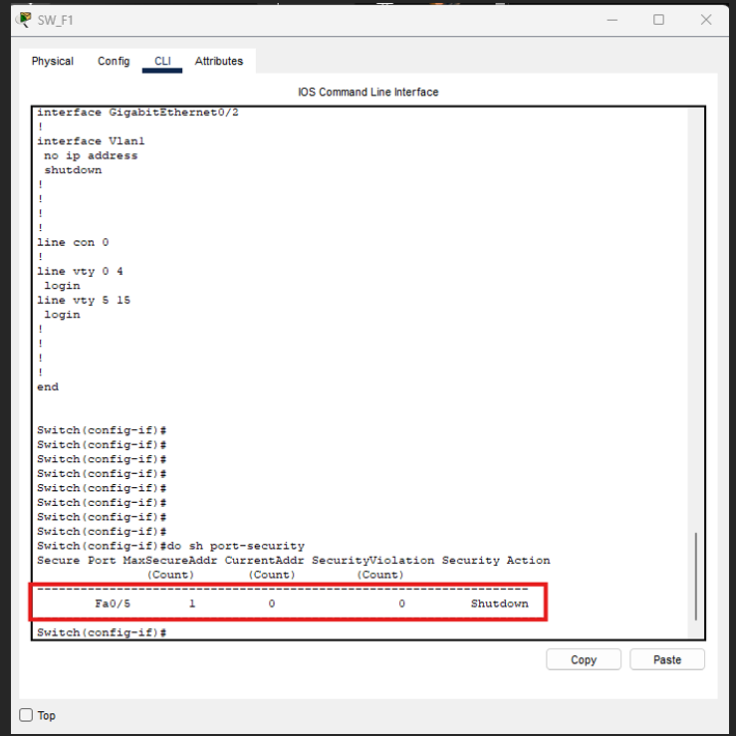
SSH Remote Access
Port Security – Rogue Laptop

Slide 8
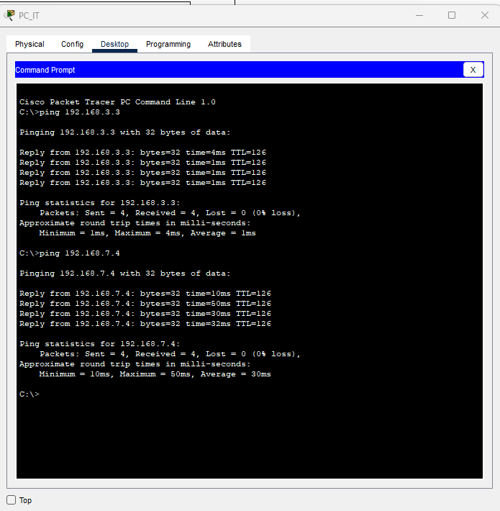
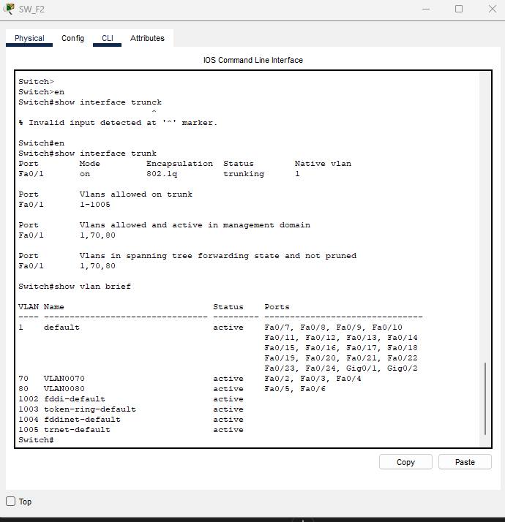
Wireless Connectivity
Trunking Evidence

Slide 9

CHALLENGES &
RESOLUTIONS
Challenge | Resolution
Inter-VLAN routing not working | Verified sub-interface IPs and trunking and the interface IP was incorrectly assigned
DHCP not reaching devices | Corrected VLAN interface bindings and scopes
SSH login failure | Adjusted domain name, key generation & user credentials
Port security shutdown on legit device | Used sticky MAC + secure MAC config

Slide 10


FUTURE
IMPROVEMENTS
Add VPN Access for secure external login
Deploy Central Authentication (RADIUS) for user management
Monitor Traffic with SNMP and syslog servers
Scalability: Add redundancy (e.g., HSRP/VRRP for router failover)
Implement Firewalls or ACLs for deeper packet filtering

Slide 11
THANK
YOU

